Slide 1
ONLINE SHOE MARKETPLACE
Group No-20 Prashanth Vobilishetty​ Sarthak Somvanshi Akshaya Gavhane Manish Kottamgari Rinki Kundu

Slide 2
OVERVIEW
The online shoe marketplace emerges as a transformative solution enabling easy monitoring of customer information,product details, orders, and vendor data with secure data handling.
Customers can effortlessly manage orders, budgets for various product categories, and track their purchasing history.
This project helps customers, suppliers to make better decisions by providing real time insights into market trends, product availability, and pricing transparency
MAIN-OBJECTIVES
Develop a centralized database system to efficiently store and manage customer information, product details, orders, and vendor data.
Seamless management of diverse shoe products, customer details, and order information.
Efficient management of inventory, transparent pricing. by enhancing cooperation among sellers, suppliers, and customers

Slide 3
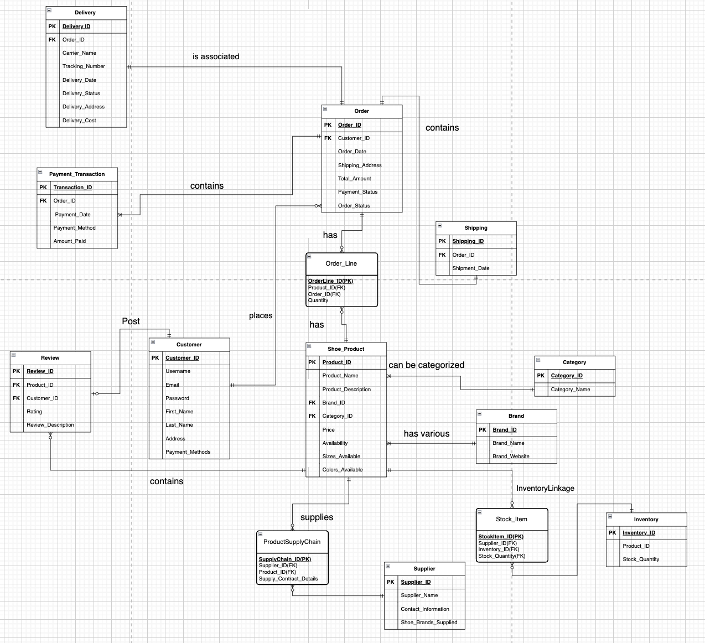
ENTITY-RELATIONSHIP DIAGRAM

Slide 4
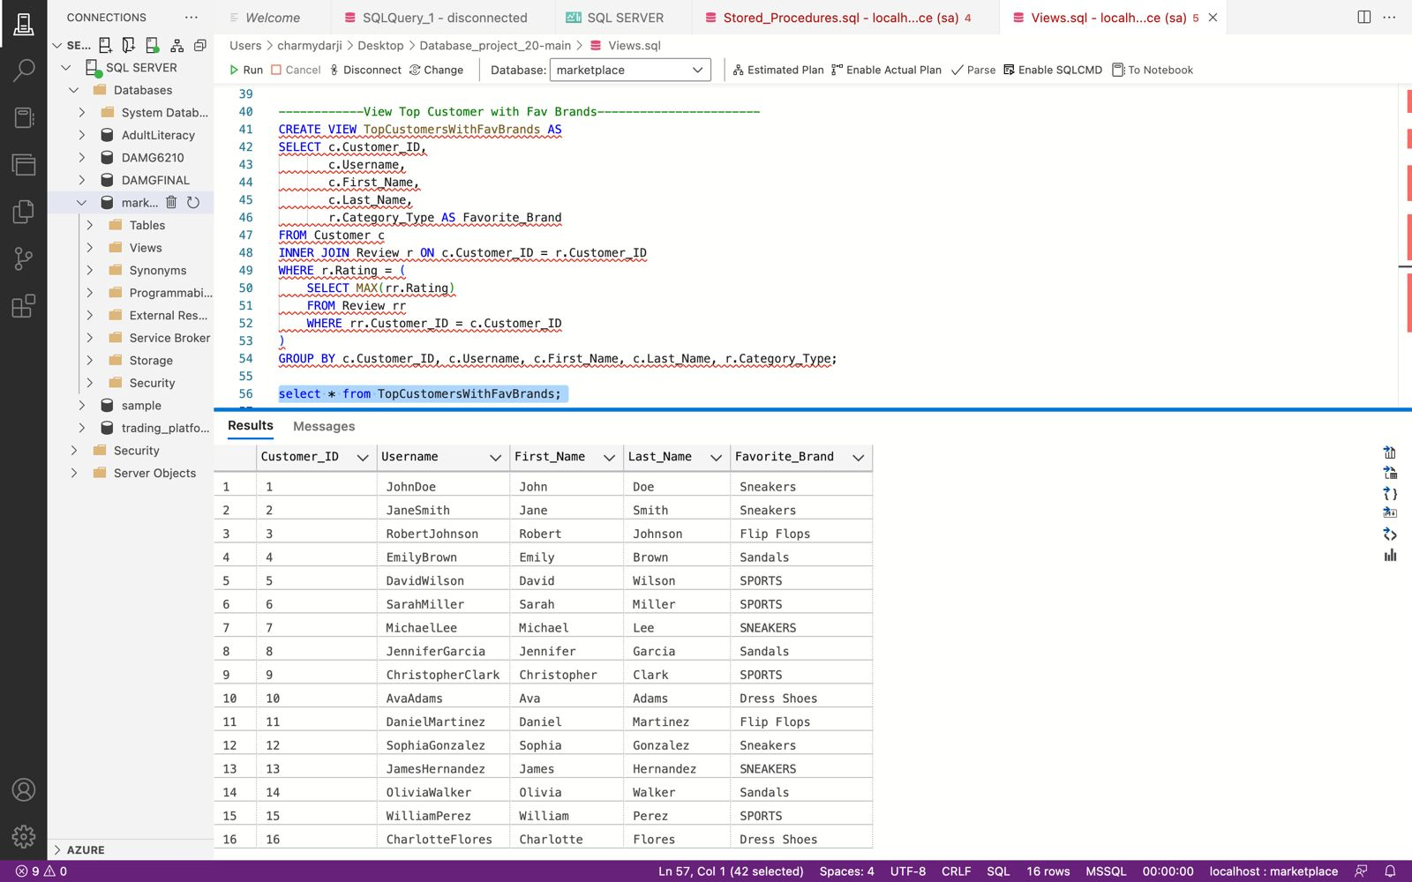
VIEW
The SQL code creates a view named TopCustomersWithFavBrands that provides information about top customers and their favorite brands based on the maximum rating they have given in reviews. The view is then queried to retrieve and display the result.

Slide 5
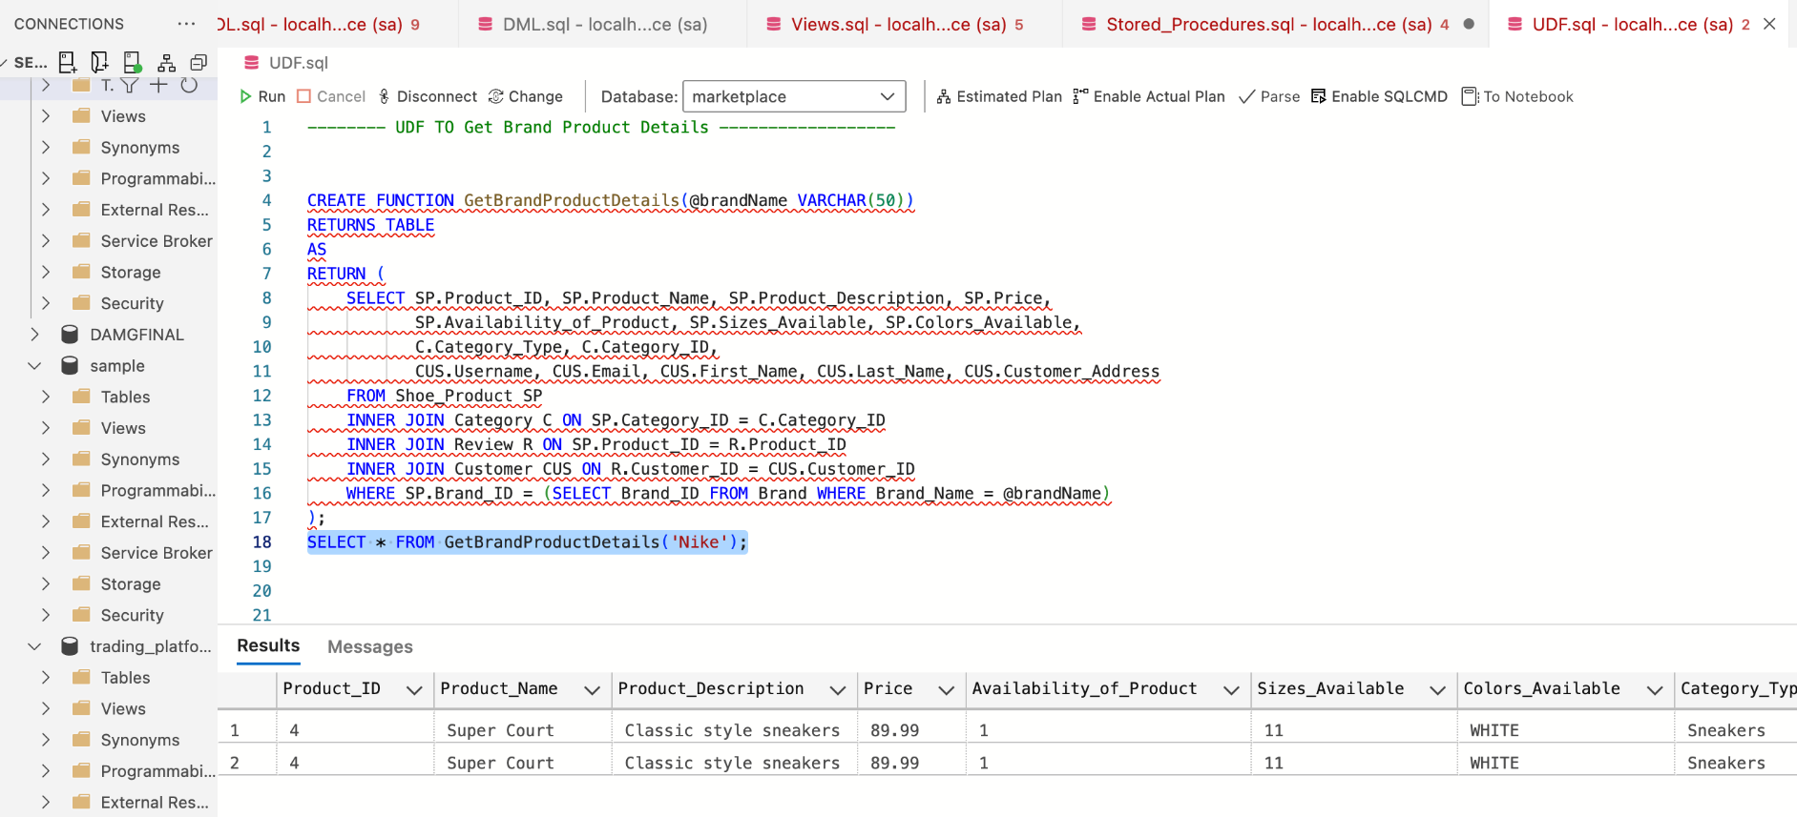
UDF FUNCTION
This SQL code defines a function that, given a brand name, retrieves and returns details about products associated with that brand, including product information, category information, and customer information for those who have reviewed the products. The example at the end demonstrates the usage of the function for the brand 'Nike'.

Slide 6
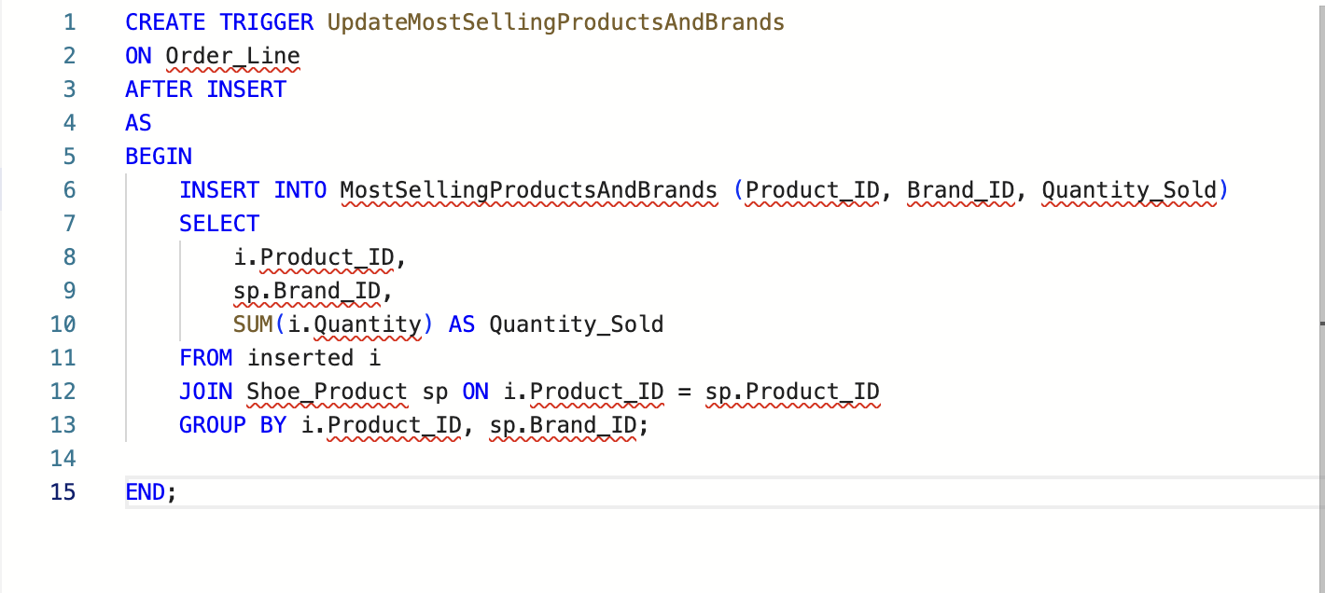
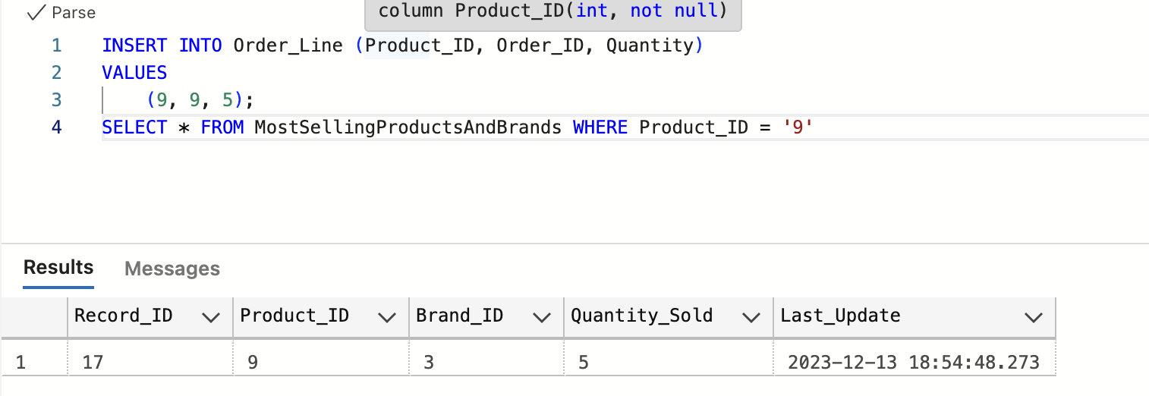
TRIGGERS IMPLEMENTED
This trigger is designed to maintain a record of the most selling products and their associated brands in the "MostSellingProductsAndBrands" table every time new orders are inserted into the "Order_Line" table.

Slide 7
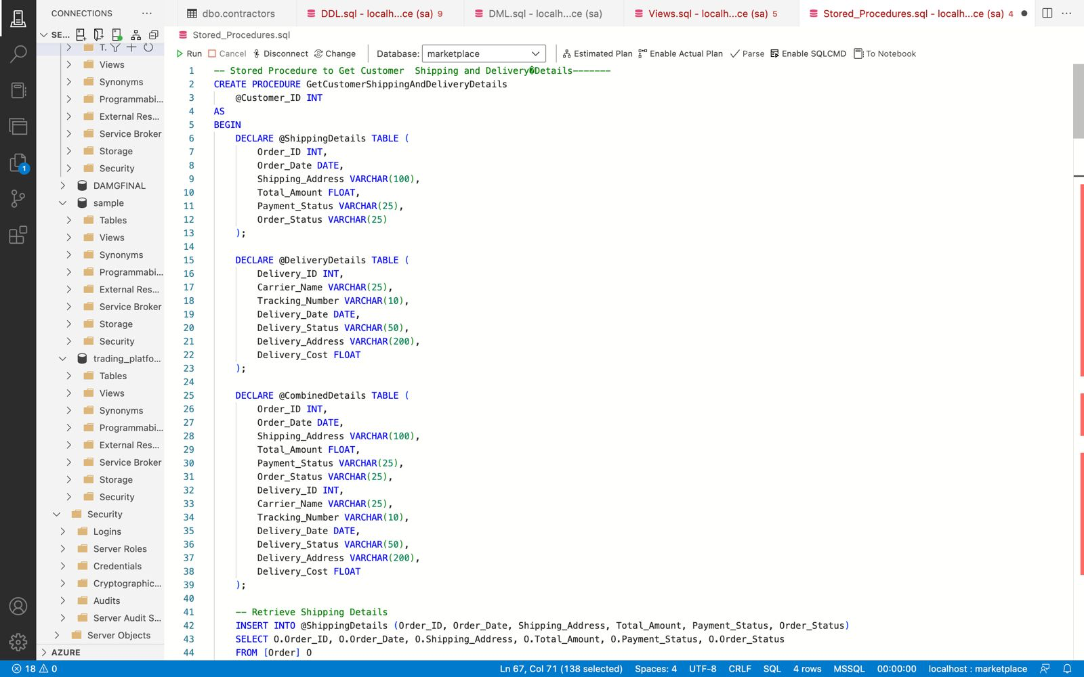
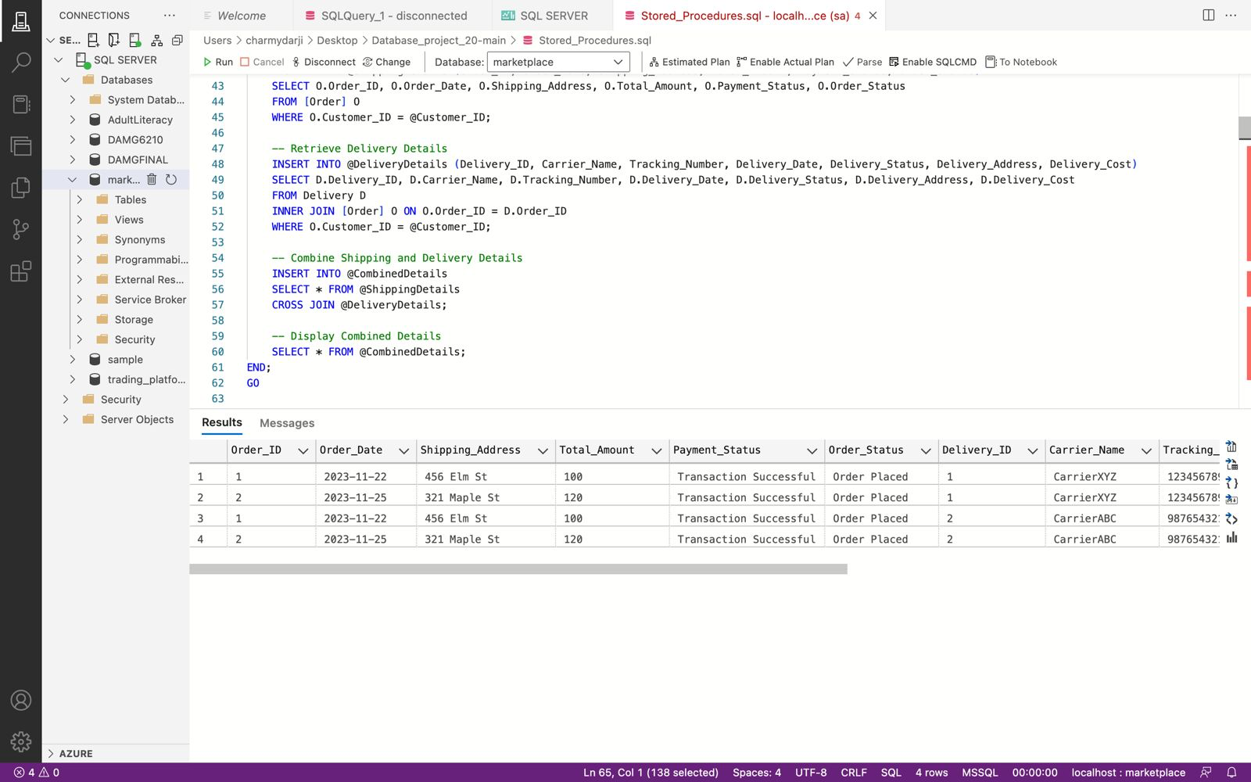
STORED PROCEDURE
The provided execution query demonstrates how to use the stored procedure by passing a specific customer ID.
The stored procedure fetches shipping details and delivery details for a given customer, combines them, and then displays the combined information.

Slide 8
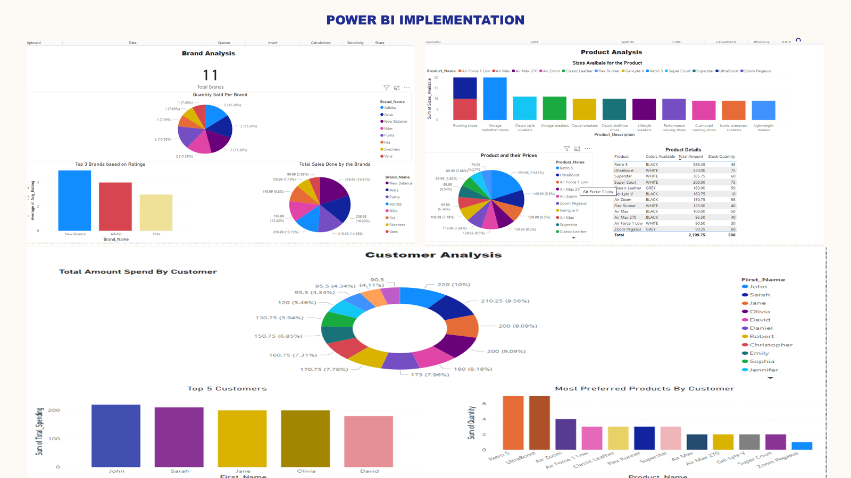
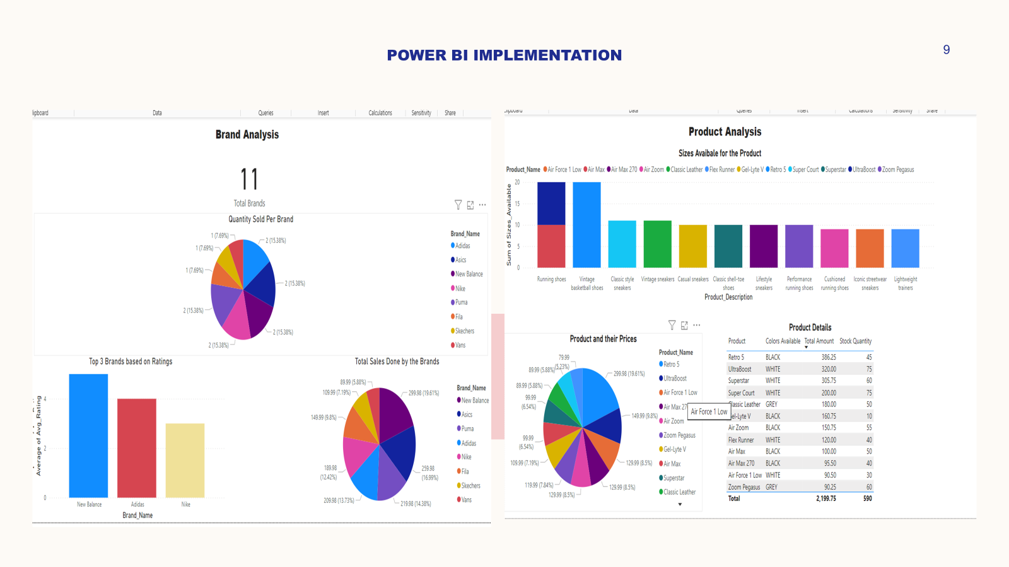





PLAN FOR PRODUCT LAUNCH
PLANNING
MARKETING
DESIGN
STRATEGY
LAUNCH
Synergize scalable e-commerce
Disseminate standardized metrics
Coordinate e- business applications
Foster holistically superior methodologies
Deploy strategic networks with compelling e- business needs

Slide 9
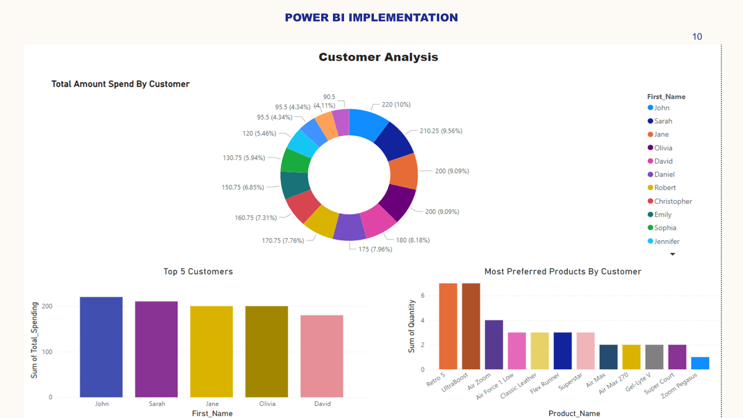
PLAN FOR PRODUCT LAUNCH
PLANNING
MARKETING
DESIGN
STRATEGY
LAUNCH
Synergize scalable e-commerce
Disseminate standardized metrics
Coordinate e- business applications
Foster holistically superior methodologies
Deploy strategic networks with compelling e- business needs

Slide 10
THANK YOU

